Slide 1
Boosting
Mikhail Lipkovich
06/26/2018

Slide 2
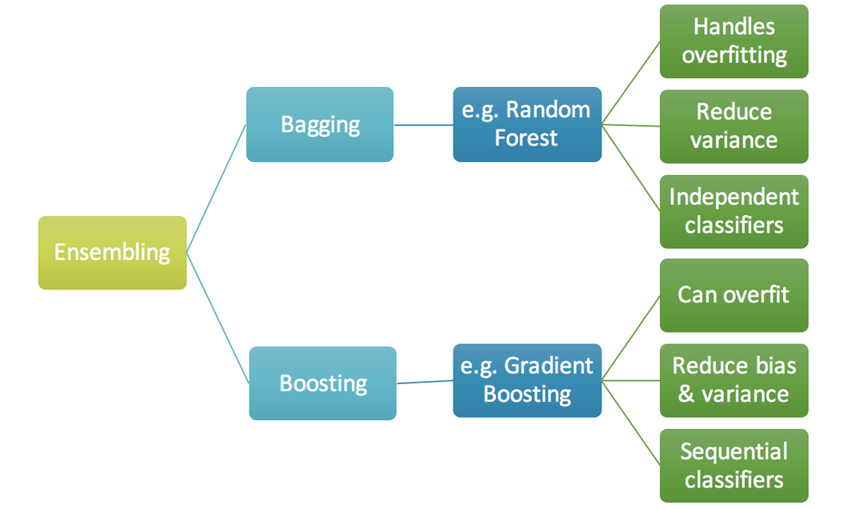
Ensembling

Slide 3
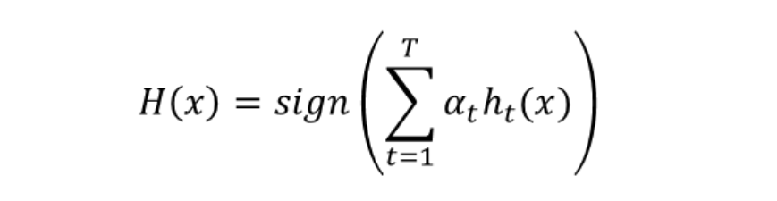
ADABoost classifier
T is amount of 'weak' classifiers
h_t(x) is the output of 'weak' classifier 't'
alpha_t is the weight applied to classifier 't'
H(x) is the final classifier

Slide 4
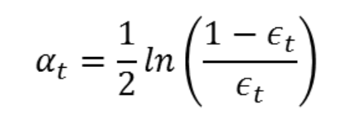
ADABoost output weights
e_t is the proportion of misclassified samples by classifier 't'

Slide 5
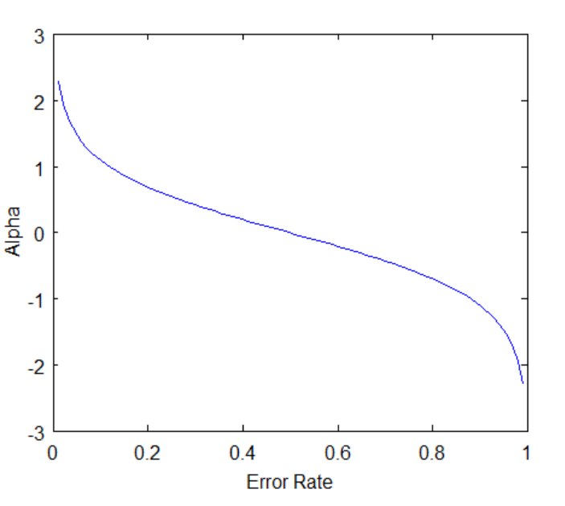
ADABoost output weights

Slide 6
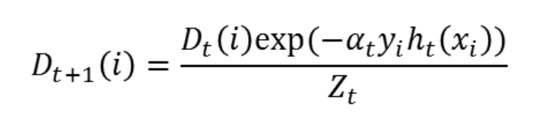
ADABoost samples weights
'i' is the training example number
D_t(i) is the probability of training example 'i' appear in the training set for classifier 't'
Z_t is the sum of all D_t

Slide 7
ADABoost algorithm
0. Set t=1
1. Initialize all D_t with ones
2. Train 'weak' classifier h_t(x)
3. Calculate its weight alpha_t
4. Calculate distribution D_{t+1}
5. Set t = t+1
6. Repeat steps 2-5 until get T classifiers
7. Resulting classifier is H(x)

Slide 8
Gradient Boosting
Roughly speaking on each iteration we build a classifier which models error from the previous classifier
There are several algorithms (GBM, XGBT)
XGBoost is the most popular implementation with several optimizations

